Slide 1
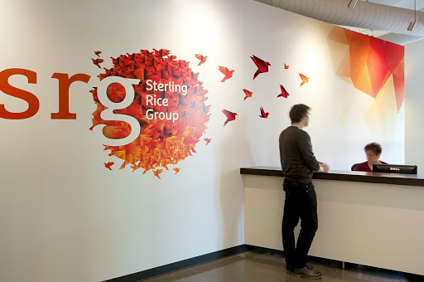
Group 16
Predictive analytics Using SAS
Srg
Savrin Darash
Karan Bhujbal
Jinx Mei
Rohanjit Singh Virdi
Prarthna Vasudevamurthy

Slide 2
Company’s objectives
WE TAKE FOOD SERIOUSLY
Professional chefs on staff, amateur foodies on call.
WE SEE ART IN UNEXPECTED PLACES
Statement making sneakers, one of a kind swag.
WE LIVE TO SKI/SHRED
Bragging aside, we're pretty awesome.
YOU DON'T HAVE TO BE YOUNG TO BE IDEALISTIC
We're 30 years old and still living our values.
WE LOVE OUR DOGS
At last count we had 40+ office dogs.
WE GIVE CHEERS
It's 11a.m. or 5 o'clock somewhere.
Health conscious culinary
Sport and exercise
Animal friendliness
Beverages
Company’s values
& Interests

Slide 3

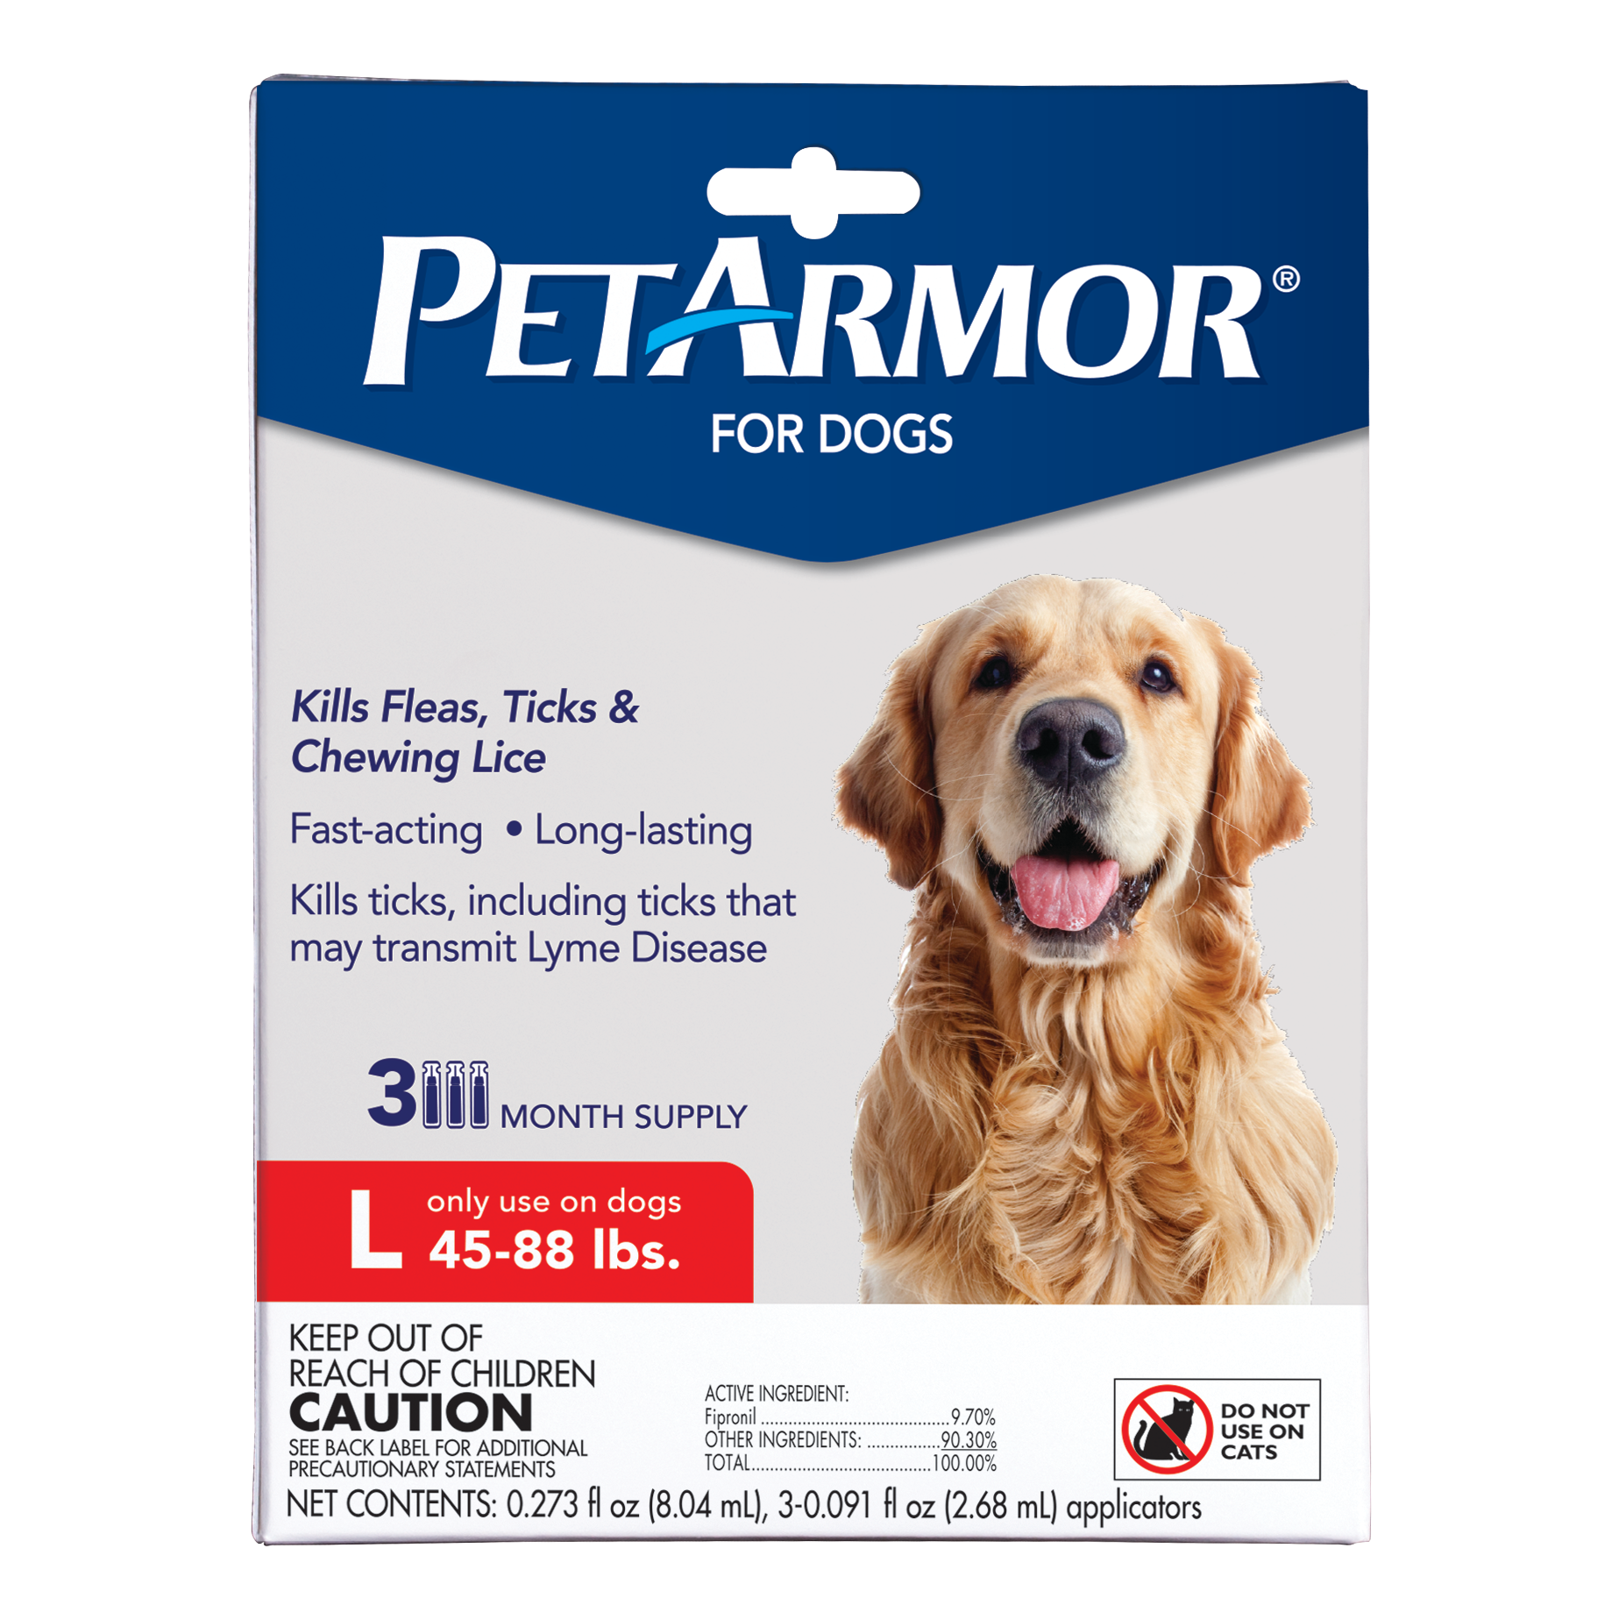
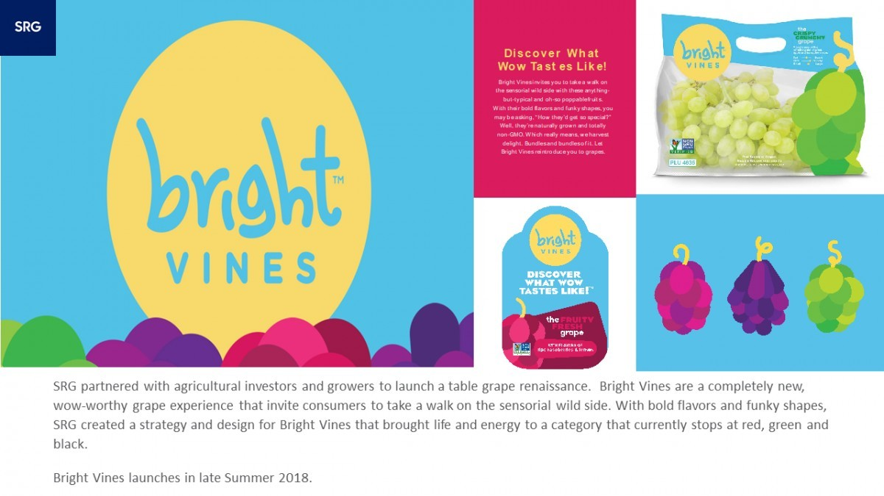
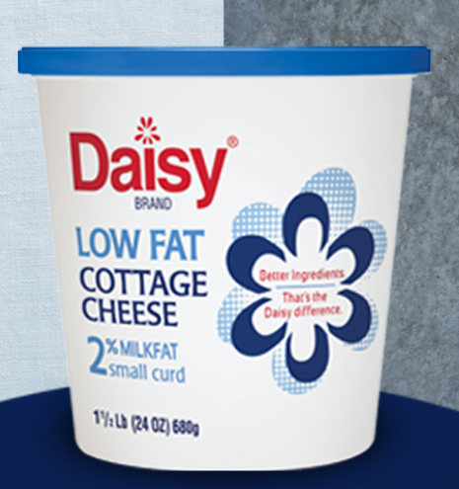





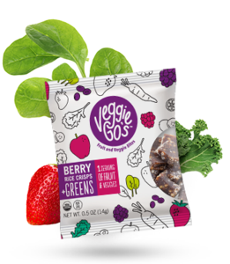



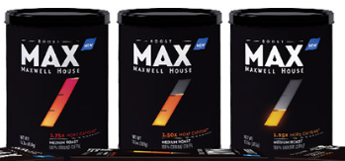

SRG’s costumers and services
BRAND DESIGN
PACKAGING DESIGN
BRAND POSITIONING
CULINARY TRENDS & MAPPING
ENVIRONMENTAL DESIGN
BRAND STRATEGY
CONSUMER INSIGHTS

Slide 4
SRG Proprietary Study 2015
What is it about ? Health and wellness.
The survey is made up of 30 questions consisting of questions about Personal information such as age, gender, income, and ethnicity (demographic data)
There are questions about the wellness and lifestyle( attitudinal and motivation data).
There are also questions on food and snack choices and frequency and time of their consumption
With focus on dinner and time and energy that customer is willing to invest on making it.

Slide 5
Health
In 1946, the World Health Organization (WHO) defined health as “a state of complete physical, mental, and social well-being, and not merely the absence of disease or infirmity.”
Measures of
physical Health
from the dataset
Such as :
Weight
Height
BMI

Slide 6
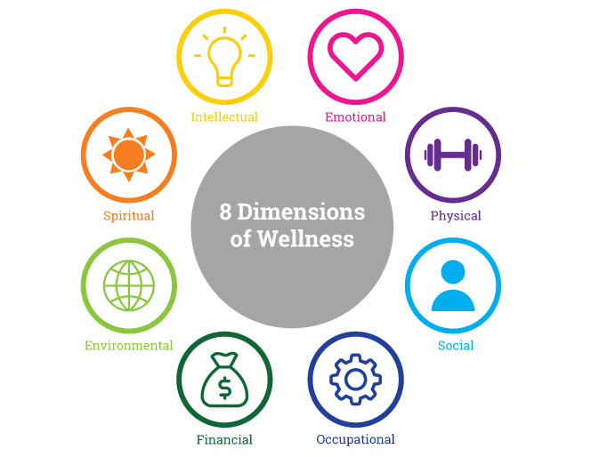
Wellness
The Global Wellness Institute defines wellness as the active pursuit of activities, choices and lifestyles that lead to a state of holistic health.
Measures of
Mental Wellness
from the dataset
Such as :
Satisfaction
Attitude
Motivation
{points,
Attitudinal,
Mindset on self-healthiness }

Slide 7
Data Set
The dataset structure
Original dataset:
1003 rows and 1151 columns
Cleaned and transformed dataset:
982 rows and 372 columns
Questions and variables that were not used:
Q27,28,29 and q-time
Missing data were replaced using mode() for categorical data , mean() for numerical data

Slide 8
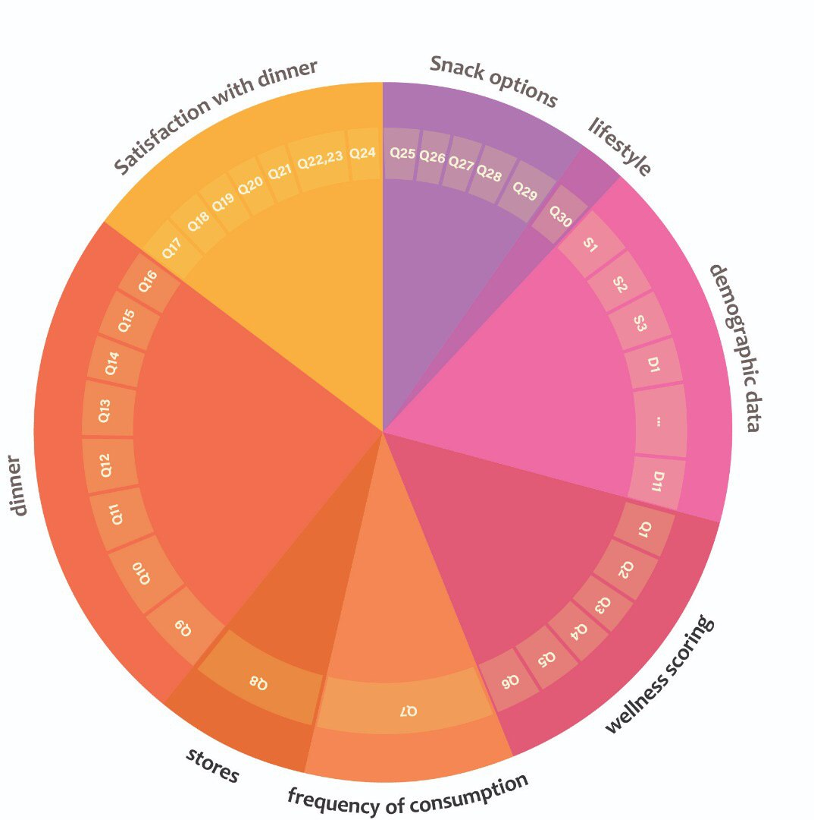
Survey and Data partitions
Demographic Data
Wellness scoring
Food choice and frequency of their consumption
Stores
Dinner choices
Satisfaction with dinner
Snack options
Lifestyle

Slide 9
Processing and transforming the data
VIZUALIZATION & data cleaning
EDA and Insights
Feature engineering
Donut chart
Bar chart
Stacked bar chart
Distribution plot
histograms
Correlation heat map
We have included all the vizualizations per Question in a separate document.
We hve included the important ones in the coming slides and the report.
We have created a new variables for most section of the data trying to capture and summarize their nature and information they have. We mostly have used the score point that the survey makers have suggested unless it was impractical.

Slide 10
EDA and Visualization
Here you have a list of items
And some text
But remember not to overload your slides with content
Your audience will listen to you or read the content, but won’t do both.

Slide 11
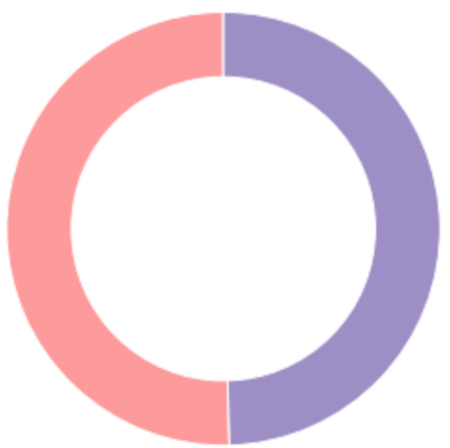
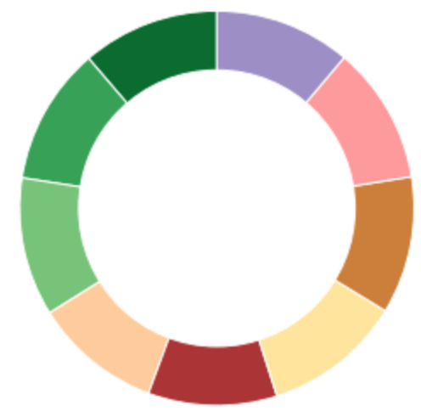
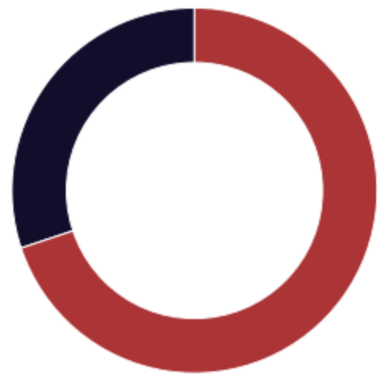
General Demographics
Gender
Age
Male
Female
49.6%
50.4%
18-24
25-29
30-34
35-39
40-44
45-49
50-54
55-59
60-65
11.3%
11.3%
11.4%
10.5%
10.6%
11.4%
11.3%
11.3%
11.2%
Marriage
Married
Not married
30.1%
69.9%

Slide 12
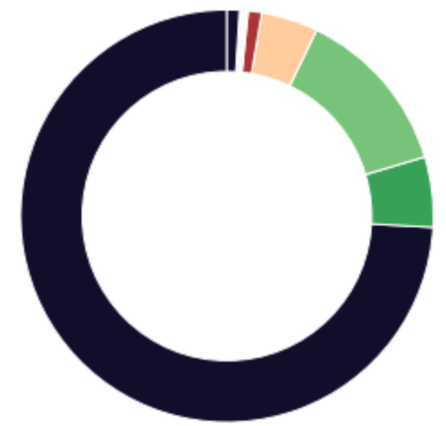
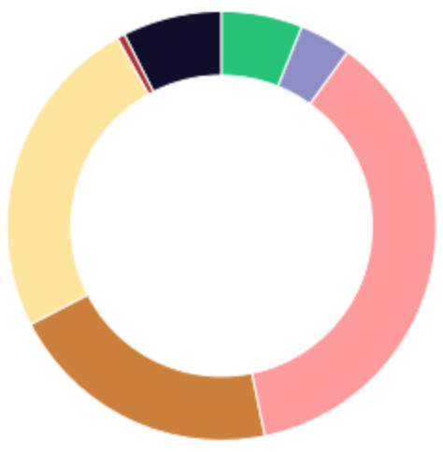
General Demographics Continued
Ethnicity
Education Background
White/Anglo/Caucasian
Hispanic
African American
Asian/Oriental
Indian
Hawaiian
Mixed
South Asian
Caribbean
Italian
middle eastern
pacific islander
Declined
74.1%
5.5%
13.2%
4.4%
1.1%
0.09%
0.09%
0.09%
0.09%
0.09%
0.09%
0.09%
0.9%
Graduate school
Declined
Bachelor
Grad high school
College
Some high school
Trade/technical
7.5%
0.6%
24.5%
20.6%
36.8%
3.9%
6.1%

Slide 13
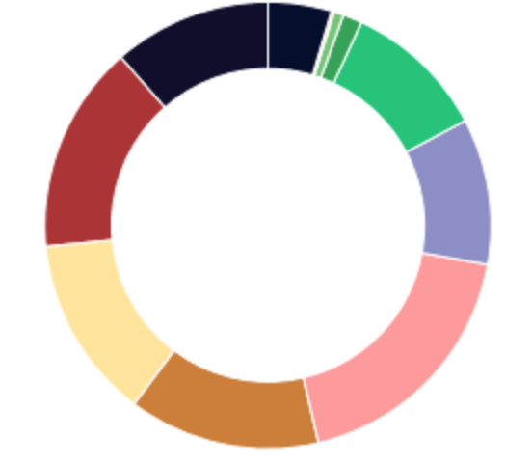
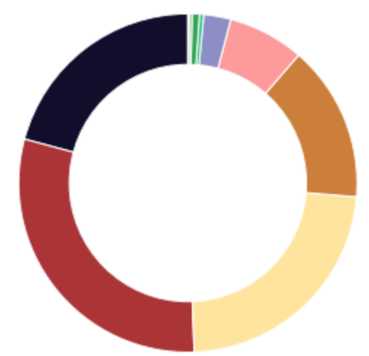
Household Demographics
Household Income
Number of people in the house
<15k
15-25k
25-35k
35-50k
50-75k
75-100k
100-200k
200-300k
300-500k
Declined
11.5%
15.1%
13.3%
13.9%
18.5%
10.6%
10.4%
1.3%
0.6%
4.6%
One
Two
Three
Four
Five
Six
Seven
Eight
Nine
Twelve
20.8%
29.8%
23.1%
14.9%
7.3%
2.6%
0.4%
0.7%
0.3%
0.1%

Slide 14
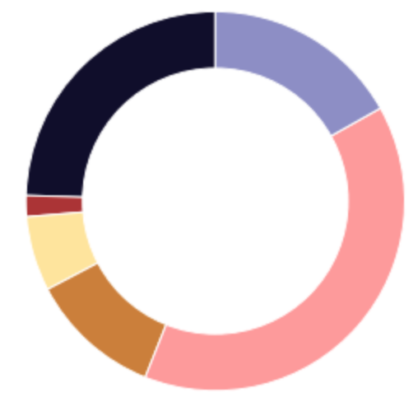
Wellness Demographics
Wellness scoring
Aspiring to wellness
Compromised to wellness
Epitomizing Wellness
Neglected Wellness
Sacrificing Wellness
Scrambling for Wellness
24.5%
1.8%
6.4%
11.3%
39.2%
16.8%

Slide 15
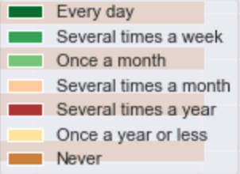
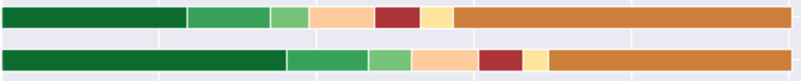
Frequency of item consumption
Items that people consume a lot
Cereal
Ground Coffee
Bottle water
Milk
Fresh vegetables
Most of the items that people consume a lot are healthy except for Sugar and Packaged cheese
Fresh Fruit
Multivitamins
Letter Vitamins
Packaged cheese
Sugar

Slide 16
Frequency of item consumption continued
Items that people hardly consume
Scotch
There is no specific pattern. Some of them is because they are rare by itself, some of them is because people have other more popular alternatives like milk for soy milk
Echinacea
CoQ10
Glucosamine
Chia Seeds
Soy Milk
Coconut Milk
Dairy free Cheese
Gin

Slide 17
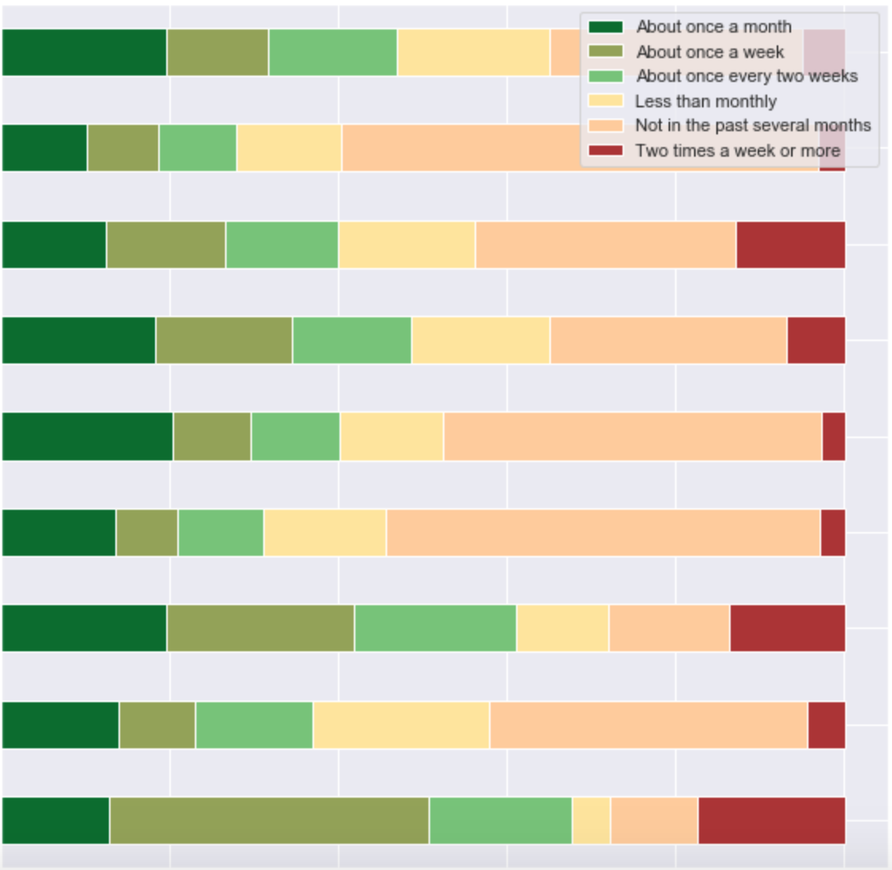
Stores
Traditional grocery store
Frequency of stores that people went to
Target
Walmart
A natural food store like Whole Foods
A club store like Costco or Sam's
People went to pharmacy and convenience store more than others. Few people went to a dollar store or a club store like Costco
A dollar store
A convenience store
A discount supercenter
A pharmacy such as Walgreens or CVS

Slide 18
Health and wellness Indicator (Target variables)
Wellness
We are using the “points” variable.
Levels of point are:
Epitomizing Wellness
Aspiring to Wellness
Sacrificing Wellness
Scrambling for Wellness
Compromised Wellness
Neglected Wellness
Health
We have weight and height data in the, a good indicator of health is BMI(body mass index): weight/height^2
Levels of BMI are:
Underweight
Normal
Overweight
Obese

Slide 19
In two or three columns
Yellow
Is the color of gold, butter and ripe lemons. In the spectrum of visible light, yellow is found between green and orange.
Blue
Is the colour of the clear sky and the deep sea. It is located between violet and green on the optical spectrum.
Red
Is the color of blood, and because of this it has historically been associated with sacrifice, danger and courage.

Slide 20
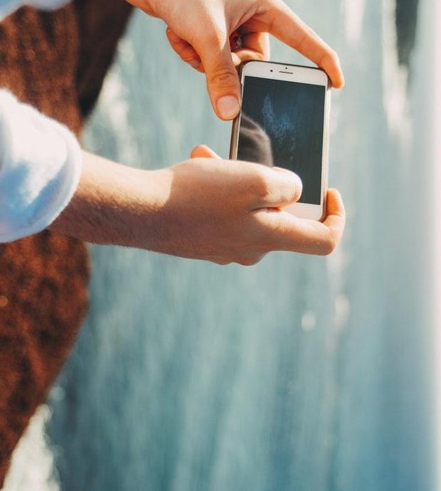
A picture is worth a thousand words
A complex idea can be conveyed with just a single still image, namely making it possible to absorb large amounts of data quickly.

Slide 21
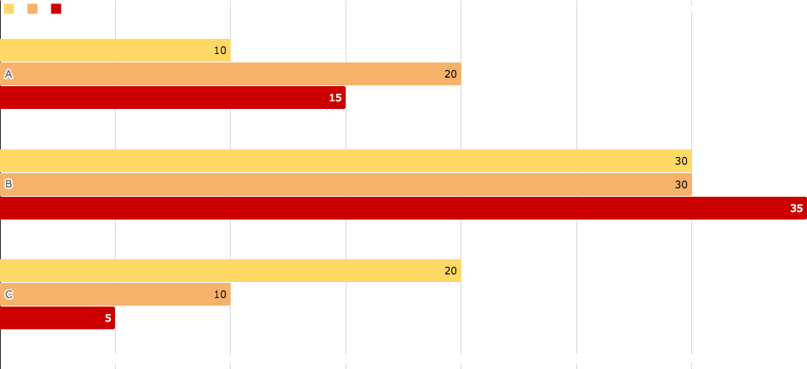
You can insert graphs from Google Sheets

Slide 22
Use diagrams to explain your ideas
01
Vestibulum nec congue tempus
Vestibulum nec congue tempus
Vestibulum nec congue tempus
03
02
Vestibulum nec congue tempus

Slide 23
And tables to compare data
 | A | B | C
Yellow | 10 | 20 | 7
Blue | 30 | 15 | 10
Orange | 5 | 24 | 16

Slide 24
Maps
our office

Slide 25
89,526,124
Whoa! That’s a big number, aren’t you proud?

Slide 26
89,526,124$
185,244 users
100%
That’s a lot of money
And a lot of users
Total success!

Slide 27
Let’s review some concepts
Yellow
Is the color of gold, butter and ripe lemons. In the spectrum of visible light, yellow is found between green and orange.
Blue
Is the colour of the clear sky and the deep sea. It is located between violet and green on the optical spectrum.
Red
Is the color of blood, and because of this it has historically been associated with sacrifice, danger and courage.
Yellow
Is the color of gold, butter and ripe lemons. In the spectrum of visible light, yellow is found between green and orange.
Blue
Is the colour of the clear sky and the deep sea. It is located between violet and green on the optical spectrum.
Red
Is the color of blood, and because of this it has historically been associated with sacrifice, danger and courage.

Slide 28
Mobile project
Show and explain your web, app or software projects using these gadget templates.
Place your screenshot here

Slide 29
Tablet project
Show and explain your web, app or software projects using these gadget templates.
Place your screenshot here

Slide 30
Desktop project
Show and explain your web, app or software projects using these gadget templates.
Place your screenshot here

Slide 31
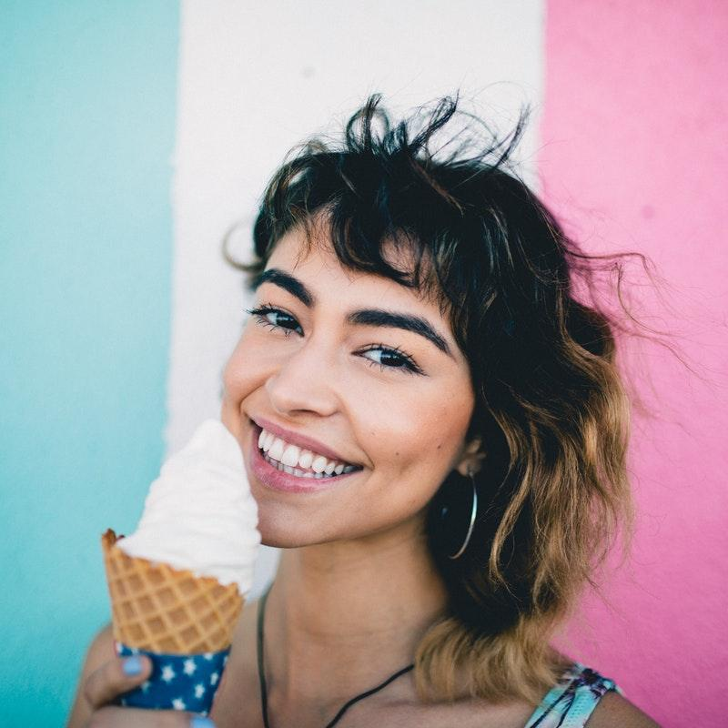
Thanks!
Any questions?
You can find me at
@username
user@mail.me

Slide 32
Credits
Special thanks to all the people who made and released these awesome resources for free:
Presentation template by SlidesCarnival
Photographs by Unsplash

Slide 33
Presentation design
This presentation uses the following typographies and colors:
Titles: Montserrat bold
Body copy: Montserrat light
You can download the fonts on this page:
https://www.fontsquirrel.com/fonts/montserrat
Yellow #ffc800 · Orange #ffa400 · Raspberry #f64646 · Crimson #e8062f
You don’t need to keep this slide in your presentation. It’s only here to serve you as a design guide if you need to create new slides or download the fonts to edit the presentation in PowerPoint®

Slide 34
SlidesCarnival icons are editable shapes.
This means that you can:
Resize them without losing quality.
Change fill color and opacity.
Change line color, width and style.
Isn’t that nice? :)
Examples:

Slide 35
😉
Now you can use any emoji as an icon!
And of course it resizes without losing quality and you can change the color.
How? Follow Google instructions https://twitter.com/googledocs/status/730087240156643328
✋👆👉👍👤👦👧👨👩👪💃🏃💑❤😂😉😋😒😭👶😸🐟🍒🍔💣📌📖🔨🎃🎈🎨🏈🏰🌏🔌🔑 and many more...

Slide 36
Thank you for your time and attention

